Slide 1







How to use this deck
Ansible Automation Platform component overview: automation mesh
Name: Ansible Automation Platform component overview: automation mesh
Purpose: Share high high level overview and technical introduction to automation mesh to customers
Last updated: Jan 7, 2022 (check history for older versions)
What this deck is for Pre-sales and technical conversations with customers
What this deck is not for This deck is not meant for business-level discussions Please use decks as outlined in the sales plays https://redhat.highspot.com/spots/57b75a51127958263ff9e1ef
Feedback / Suggestions Please send all feedback and suggestions to ansible-feedback@redhat.com. Use the slide deck name as the reference. Google Slides source link (Red Hat internal): https://docs.google.com/presentation/d/1eyDRjhpIUJrXeq9jvrf2I2T6QD1Cfj9EELpn7VP0fF4/edit?usp=sharing
Notes:
Major aim
This deck is to support sales by catering to the interest of technical personas in the customer’s decision making process.
Personas and their motivation
Technical (infra/network/security ops, but also architects and anytone responsible for AAP operations and administration)
They want or need to understand the technology. They do not buy if they don’t have sufficient insight or big open questions.

Slide 2
Automation mesh
Component overview:
Red Hat Ansible Automation Platform 2.1

Slide 3



Index
Component overview
Introduction to automation mesh and Ansible Automation Platform 2.1
What is automation mesh?
Why automation mesh?
Automation mesh configuration
Automation mesh node types
Graphing automation mesh
Migrating from Isolated Nodes to mesh
Automation mesh and Red Hat OpenShift
Enterprise deployment patterns
Execution and control installed on the control layer
Execution and control on separated layers
Multiple datacenters
Appendix
Automation mesh installer examples

Slide 4
Introduction to automation mesh

Slide 5

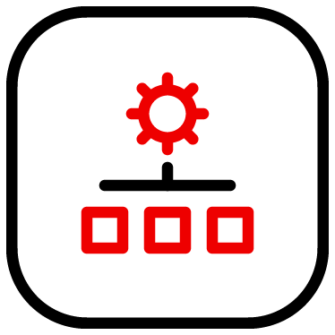

Ansible Automation Platform 2.1 release
AAP 2.1 release mesh highlights
Automation controller
Mesh replaces Isolated Nodes
Isolated Nodes are discontinued.
`Functionality is provided by automation mesh
Mesh installation
Mesh is installed using inventory installer method
New sections added to inventory file for automation mesh configuration
Installer performs sanity checks on mesh configuration
Flexible configuration and design options
Health checks
Health checks inspect execution node capacity
Health check intervals differ based on mesh node type
Graphing
AAP2 installer extra var can be set to create Graphviz dot file
Topology can be reviewed before continuing the installation
Automation Mesh
hop node
Edge
Cloud
Data center
execution nodes
execution nodes
execution nodes
Notes:
Speaker notes
Installation method
Normal [full] inventory installer method
New [execution_nodes] stanza and existing [automation controller] used to configure automation mesh nodes
Default 27199/tcp
Will add firewalld/iptable rules if those services are discovered on the node
Flexible configuration and design options such as network port
Firewall rules automatically configured if services are discovered on host
Health Checks
capacity computed from CPU, memory and other metrics
healthy execution nodes do not have regular checks
control and hybrid nodes run periodic checks
admins can trigger checks via an API POST
Graphing
AAP2 installer extra var can be set to create Graphviz dot file
Topology can be reviewed before continuing the installation

Slide 6
What is automation mesh?

Slide 7


What is automation mesh?
Simple, flexible and reliable scaling of execution capacity
Automation controller
Automate at a global scale
Simple, flexible and reliable way to scale automation of large inventories across diverse network topologies and platforms.
Distributed overlay network
Overlay network which eases distributing automation execution
Establishes peer-to-peer connections between execution nodes across existing networks
Flexible architecture
Flexible architecture offers more design choices compared to isolated nodes
Execution node health
Health checks performed on execution nodes
Automation Mesh
hop node
Remote Office
Cloud
Data center
execution node(s)
execution nodes
execution nodes
Notes:
Speaker notes
What is automation mesh?
A flexible architecture which provides much more choice than isolated nodes
An overlay network intended to ease the distribution of work across a large and dispersed collection of workers. Automation mesh establishes peer-to-peer connections with each other via existing networks.
Connects control and execution planes
Health Checks
capacity computed from CPU, memory and other metrics
healthy execution nodes do not have regular checks
control and hybrid nodes run periodic checks
admins can trigger checks via an API POST

Slide 8
Why automation mesh?

Slide 9












Ansible Tower and isolated nodes ( Pre Mesh )
Tightly coupled control and execution
Ansible Automation Platform
Static capacity management
Control and execution planes scaled as a whole unit
Changing capacity requires downtime (outside of Openshift)
Control and execution cluster capacity shared
Managing execution capacity increases in complexity as it grows
Deployment limitations
Execution capacity limited to a single cluster
Closely coupled to the database and requires low latency
Isolated node constraints
One way communication from the controller cluster using SSH
Additional hosts needed for remote execution (Jump hosts, SSH proxies)
Extremely sensitive to latency
Low resilience to connection disruption
WebUI
API
RBAC
Workflows
Audit
Execution
virtualenvs
Notes:
Speaker notes:
Cluster capacity is static
scaled as a whole unit
adding/removing capacity = downtime (outside of Openshift)
Control and execution cluster capacity shared
tracking and managing available/used capacity becomes increasingly complex with scaling
Deployment limitations
outside of isolated nodes, capacity limited to a single cluster, closely coupled to the database and low latency requirements
SSH limitations (isolated nodes)
one way communication from the cluster, often requiring jump hosts/proxies
very sensitive to latency, somewhat sensitive to connection disruption

Slide 10



Automation mesh and automation controller
Simple, flexible and reliable execution scaling
Dynamic cluster capacity
Cluster capacity scales independently
Aims to scale and manage execution capacity without downtime
Decoupled execution and control plane
Deploy execution capacity where it’s needed
Reduced operational overhead and control footprint
Scale globally
Execution plane resilient to latency and connection interruptions
Scale across segmented and remote networks
Natively build redundant mesh topologies
Improved communications and security
Bi-directional communication between execution nodes
Multi-hopped mesh communication capabilities
Access Control Lists
TLS authentication and end-to-end encryption
Centralized management with automation controller
Automation controller
WebUI
API
RBAC
Workflows
Audit
Automation mesh
execution node
execution node
execution node
Notes:
Speaker notes
The automation mesh component of Ansible Automation Platform provides a simple and reliable framework for scaling automation. With a flexible, multi-directional communication layer, automation mesh enhances an organization’s ability to truly operate at a global scale. With less sensitivity to latency and connection disruption and native peering capabilities, you can reach further with enhanced reliability compared to any other automation platform on the market today. With security features such as TLS authentication and encryption, and additional access controls, you can rely on Ansible Automation Platform to securely expand the boundaries of what is possible for your entire enterprise IT estate.
Cluster capacity is dynamic
scale independently
aim is to create, register, group, ungroup, deregister without downtime
Control and execution plane segregation
deploy execution capacity from the control plane
Share execution capacity from multiple control planes
Deployment choices
resilient to latency and connection interruption and mesh routing changes
Connectivity
bidirectional, multi-hopped mesh communications
FIPS compliant encryption [controller]
ACLs, signing
Supports mutual TLS authentication and encryption for above and below the mesh connections.
[today] execution nodes need access to a container image registry

Slide 11
What’s changed?

Slide 12
Ansible Tower and Isolated Nodes replaced
Automation controller and mesh replace Isolated Nodes and Tower
Automation controller
Isolated nodes discontinued
Isolated nodes discontinued in AAP 2
Isolated node functionality is provided by automation mesh and controller
Process isolation
Ansible Tower bubblewrap process isolation replaced with container (EE) isolation
What concepts remain the same?
Instances and Instance Groups remain and used to configure automation mesh in controller
Container Groups remain
WebUI
API
RBAC
Workflows
Audit
Automation Mesh
execution node(s)
execution node(s)
execution node(s)
Notes:
Speaker notes
Pre Mesh: bubblewrap process isolation in Ansible Tower needed for job isolation
Mesh: containers and EEs (with container process isolation)
Instances, Instance Groups and Container Groups still exist

Slide 13
Automation mesh configuration
Introduction to automation mesh

Slide 14
Automation mesh configuration
Flexible configuration options with opinionated, best-practice defaults
Automation controller
Configuration tools
CLI tools provided to manage mesh configuration and services
Flexible configuration
Customize settings such as network settings, worker types
Flexible architecture configuration
Opinionated, sensible defaults provided for AAP functionality
Reload facility minimizes mesh operations interruptions
Connectivity
Configure how mesh handles connectivity disruption
Customizable cost metric used by automation mesh routing
Security
Firewall rules are configured for inter-node communication
Configured end-to-end TLS encryption using installer based or
customer provided certificates
Automation Mesh
hop node
Remote Office
Cloud
Data center
execution node(s)
execution nodes
execution nodes
Notes:
main CLI tools today
receptor - configuring/connection the mesh. AAP Installer setups up config file.
receptorctl - interact with the mesh control services for operational things
/etc/receptor/receptor.conf
very flexible architecture any port etc
We opinionated in order to provide sensible defaults and support AAP functionality
reload facility allows for limited interruption to mesh operations
defines worker types that are used (local, ansible-runner & k8s related)
Secure
firewall rules for inter node communication - accept, drop, reject traffic
TLS certification for end-to-end encryption, below and above the mesh

Slide 15
Automation mesh node types

Slide 16






Automation mesh node types
Control plane
Automation controller
Hybrid
Default node type for controller nodes
Perform controller functions and execute automation
Control
Capacity is dedicated to controller functions
Automation execution capability is disabled
Control plane
controller functions
controller functions and execution
type:control
type: hybrid
Automation mesh
execution node(s)
Execution plane
Notes:
Hybrid node
Default for controller nodes
Responsible for controller runtime functions like project updates, management jobs and [ansible-runner] task operations
Will also be used for automation execution
[automationcontroller]
aapc1.local ansible_connection=local node_type=hybrid
Control node
Controller nodes with execution capabilities disabled
[automationcontroller]
aapc1.local ansible_connection=local node_type=control

Slide 17
Automation mesh node types
Execution plane
Automation controller
Control plane
What is the execution plane and why is it important?
Execution and hop nodes are collectively known as the execution plane
Run automation closer to the devices and systems that need it
Flexible designs possible across geographies and networks
Resilient to high latency and connection disruptions
Run automation without direct connection to controller
Execution node
Replaces Isolated Nodes and fulfills same functions
Dedicated to run automation on behalf of controller
No controller runtime functions executed
Job isolation via podman and execution environments
Hop node
Replaces need for jump hosts
Dedicated to route traffic to other execution nodes
Cannot execute automation
node type: hybrid or controller
Automation mesh
Connects segmented environments
Resilient to high latency and connection disruptions
hop node
Executes automation locally in environments
Execution plane
segmented environment
Remote location
execution node(s)
execution node(s)
Notes:
execution
execute automation on behalf of controller nodes
no control functions
runs jobs under ansible-runner with podman isolation
(work-command: in receptor.conf)
akin to isolated_nodes
[execution_nodes]
aape1.local
hop
akin to a jump host
will route traffic to other execution nodes
cannot execute automation
[execution_nodes]
aaph1.local node_type=hop

Slide 18
Graphing automation mesh
Introduction to automation mesh

Slide 19

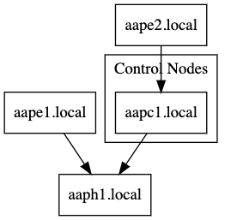
Graphing automation mesh
Visual overview of mesh topology
Graphviz dot file
AAP2 installer extra var can be set to create Graphviz dot file
during installation or run using a tag to generate the mesh dot file only
Topology can be reviewed before continuing the installation
Mesh validation
Validation modules are called during AAP installation to perform checks
Playbook can be run to check mesh connectivity
Notes:
Speaker notes
Mesh validation methods:
Installer extra var to create GraphViz file during full installation:
-e generate_dot_file=filename can be used with setup.sh to produce a graph dot file
AAP installer tag to only generate the GraphViz dot file:
./setup.sh -- --tag generate_dot_file
The installer gives you the option to cancel out so this can be reviewed

Slide 20
Automation mesh in controller
Introduction to automation mesh

Slide 21
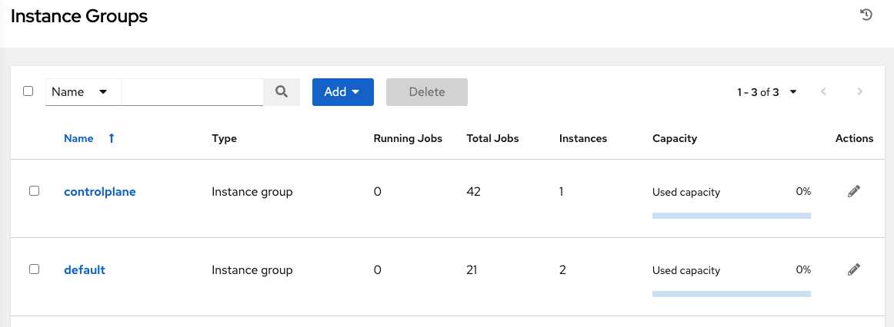
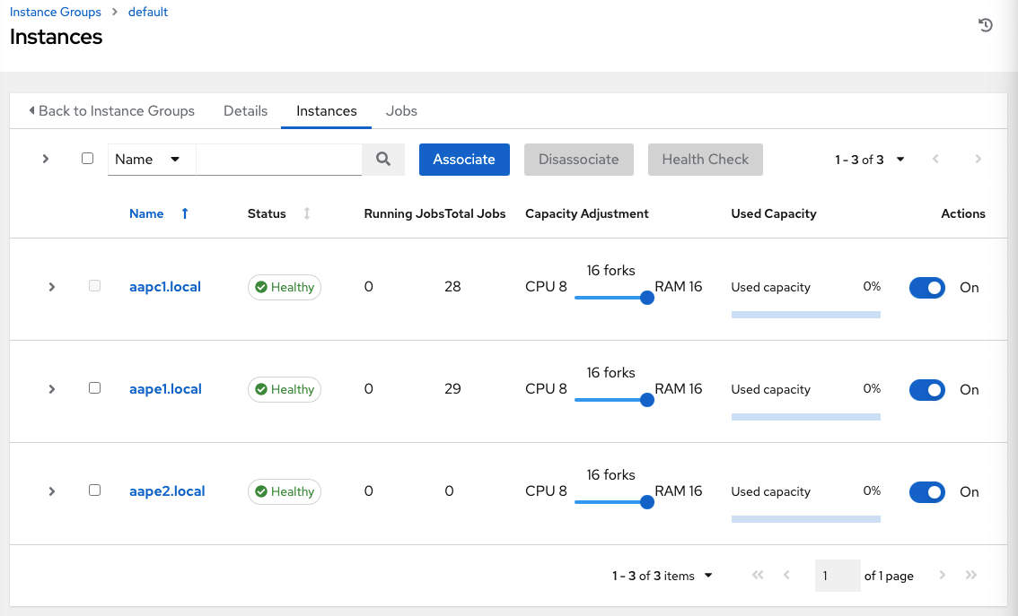
Automation mesh in controller
Default and controlplane Instance Groups
‘default’ Instance Group
Preselected Instance Group for mesh execution nodes
Always present in automation controller
Used as default if no Instance Group is defined for job execution
‘controlplane’ Instance Group
Preselected Instance Group for mesh controller and hybrid nodes
Further changes to Instance Groups can be made via the installer
inventory file or post-install via the API/UI
Notes:
https://docs.ansible.com/automation-controller/latest/html/administration/containers_instance_groups.html
The automation controller installation creates to Instance Groups namely ‘default’ and ‘controlplane’

Slide 22
Migrating from Isolated Nodes to automation mesh

Slide 23
Migrating from Isolated Nodes to mesh
Isolated Nodes replaced with automation mesh
AAP 2.1 Inventory converter
Recommendations made on previous conventions detected in AAP installer inventory e.g ‘isolated_nodes’ stanza
Applied to AAP 1.x - 2.0 installer inventory files when upgrading to AAP 2.1
Mesh validation
Graphviz dot file created with AAP 2.1 installer
Topology can be reviewed before continuing with installation
AAP 2.1 installer runs mesh validation checks before installing
Playbook can be used to validate mesh connectivity
Notes:
PRE AAP 2.1 INVENTORY CONVERTER
will detect previously used conventions like isolated_nodes and suggest a new inventory definition
MESH VALIDATION
-e generate_dot_file=filename can be used with setup.sh to produce a graph dot file
the installer gives you the option to cancel out so this can be reviewed
the installer calls the mesh validation module making some validation checks
playbook can be run to check mesh connectivity
other support guides, documentation and utilities will be provided

Slide 24
Automation mesh and Red Hat OpenShift

Slide 25
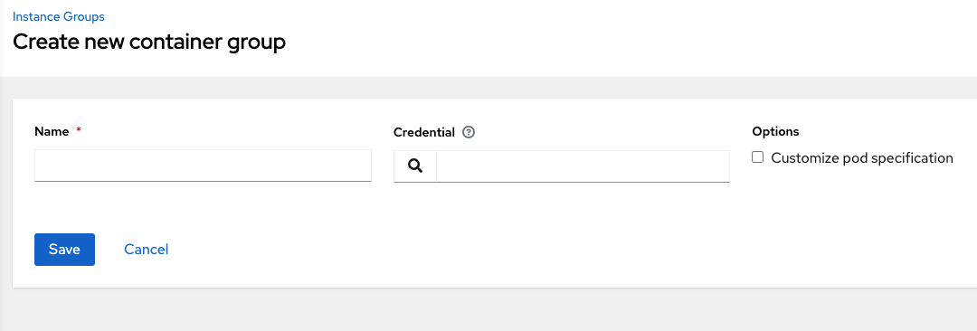
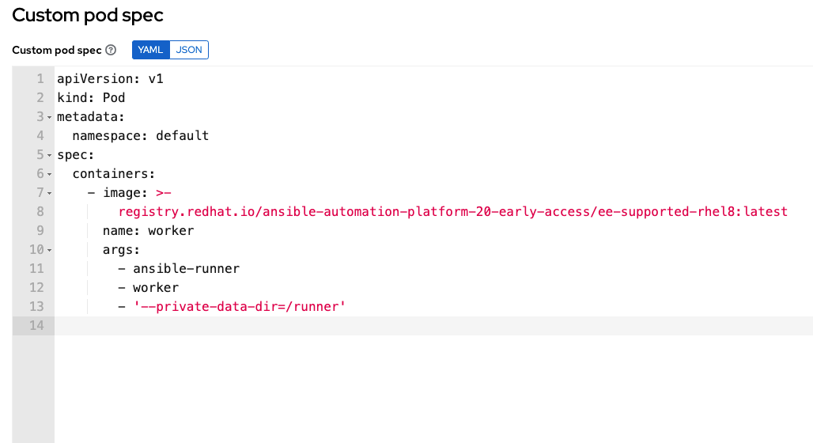
Ansible Automation Platform Container Groups
Executing automation using container platforms
What is a Container Group?
Type of Instance Group that specifies provisioning an OpenShift / Kubernetes pod to run a job
Ephemeral execution. Pods exist only for playbook run duration
Will Container Groups change with mesh?
No. Container Group functions stay the same.
Uses existing OpenShift cluster
Needs the correct pod privileges
Notes:
Container Groups are a type of Instance Group that specify a configuration for provisioning a pod in a Kubernetes or OpenShift cluster where a job is run. These pods are provisioned on-demand and exist only for the duration of the playbook run.
https://docs.ansible.com/automation-controller/latest/html/administration/containers_instance_groups.html#ag-container-groups
same as previous releases
point to an existing openshift cluster
need pod privileges
no functional change

Slide 26
Enterprise deployment design patterns

Slide 27
Design pattern 1
Install control nodes and run execution on the control layer
Scenarios
Demo
AAP functionality trial
Minimal setup and resources

Slide 28


Starter ++ Setup: Multi Controllers [with external DB]
node type: hybrid
Local Site
Automation runs on controller
based on availability / capacity algorithm
INSTANCE GROUPS:
controlplane
default
INSTANCES:
controller1 hybrid
controller2 hybrid
controller3 hybrid
Automation
Automation mesh
Automation controllers
Control plane nodes are automatically peered together through the installer. User does not have to specify this or take any action.

Slide 29
Design pattern 2
Install control and execution [peer] nodes and run automation on a separate execution layer
Scenarios
Separation of duties
HA/SPOF minded
Future scalability

Slide 30


Scaleable Starter Setup: Controllers (1)/Execution Nodes(2) + Hop (1)
Local Site
Automation runs on execution nodes only
node type: control
Automation
Local LAN
Execution Node
INSTANCE GROUPS:
controlplane
default
DMZ
INSTANCES:
controller1 control
peer1 execution
peer2 execution
hop1 hop
Automation controller
Automation mesh
DMZ
We can only get to this execution node in the DMZ through the hop node. The hop node cannot do automation
Automation
Hop Node
Execution Node

Slide 31
Scaleable Starter Setup: Multi Controllers (3)/Execution Nodes(2)
node type: control
Local Site
Automation runs on execution node(s)
based on availability / capacity algorithm
INSTANCE GROUPS:
controlplane
default
INSTANCES:
controller1 control
controller2 control
controller3 control
peer1 execution
peer2 execution
Automation
Automation mesh
Execution Node(s)
Automation
Automation controllers 1-3
Controllers are peered to all execution nodes so there is redundancy and capacity

Slide 32
Design pattern 3
Multiple datacenters
Scenarios
Resilience
Cross site services replication or availability

Slide 33


Multi DC Setup: flat, connected cross site network
DC1
node type: hybrid or control
perimeter access measures
Automation
Execution Node(s)
INSTANCE GROUPS:
controlplane
default
DC1
DC2
INSTANCES:
controller1-n
peer1 execution [DC1]
peer2 execution [DC1]
peer3 execution [DC2]
peer4 execution [DC2]
Automation
WAN, MPLS, stretched VLANS etc
Designed to provide a flat connected network
Automation mesh
DC2
Automation
Controllers could be in either DC and used for execution as well or just control plane
Caveats as before Mesh around cross site database connectivity etc
Execution Node(s)
perimeter access measures
Automation

Slide 34
Multi DC Setup: multiple zoned network segregation
DCn
Hop Node(s)
node type: hybrid or control
perimeter access measures
untrusted zone
INSTANCE GROUPS:
controlplane
default
DC1
DC2
INSTANCES:
controller1-n
hop1-n
peerz1-n execution [DCn-zone1]
peerz2-n execution [DCn-zone2]
trusted zones
Execution Node(s)
Execution Node(s)
Automation mesh
Controllers could be on corporate LAN or in either DC and used for execution as well or just control plane
Caveats as before Mesh around cross site database connectivity etc
Automation
Automation

Slide 35

Multi DC Setup: global distribution xn (multi hops)
DCn - hopzone1
A pool of execution nodes for automation demands
node type: control
Execution Node(s)
Automation
INSTANCE GROUPS:
controlplane
Default
hop_nodes
hopzone1/2
INSTANCES:
controller1-n
hop1-n
peerz1-n execution [DCn-hopzone1]
peerz2-n execution [DCn-hopzone2]
perimeter access
Automation mesh
Hop Node(s)
Execution Node
Automation
xn controllers for scale and resilience
Caveats as before Mesh around cross site database connectivity etc
Hop Node(s)
DCn - hopzone2
(maybe regional office/store with limited capacity due to bandwidth or budget)
Cloud based automation needs over VPC/Virtual Nets etc

Slide 36
Thank you

Slide 37
Appendix: Automation mesh installer examples

Slide 38
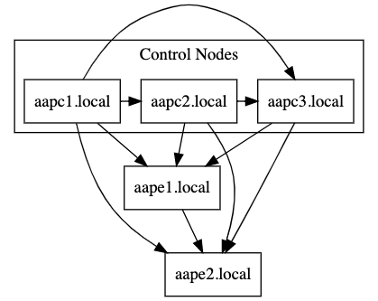
3 controllers, 2 exec nodes for HA
controller node - control only (see :vars) - no execution
defines node_type for all controllers
automatically peer all controllers to all execution nodes
peers aape1 to aape2 for resilience
[automationcontroller]
aapc1.local ansible_connection=local
aapc2.local
aapc3.local
[automationcontroller:vars]
node_type=control
peers=execution_nodes
[execution_nodes]
aape1.local peers=aape2.local
aape2.local

Slide 39
1 controller, exec node + hop node with exec node
controller node - control only - no execution
peers the controller to the hop node
defines aaph1 as the hop [relay] node
peers aape1 to the hop node (only way to access)
peers aape2 directly to controller aapc1
[automationcontroller]
aapc1.local ansible_connection=local node_type=control
[automationcontroller:vars]
peers=aaph1.local
[execution_nodes]
aaph1.local node_type=hop
aape1.local peers=aaph1.local
aape2.local peers=aapc1.local

Slide 40
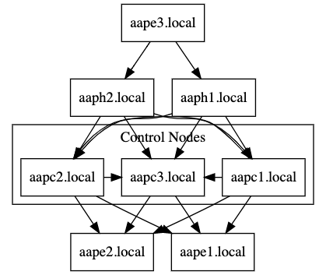
3 controllers, 2 exec nodes + 2 hop nodes with exec node
hybrid nodes / auto peered together
peers the controllers to the directconnected execution nodes group (ignores hop nodes)
define all execution node types here:
associate aape3.local with the hop_nodes group
specify which nodes are hops
By using the instance_group_ prefix this will add these nodes into the UI as an instance group via the installer automatically
peer the hop_nodes group back to the automationcontroller group
[automationcontroller]
aapc1.local ansible_connection=local
aapc2.local
aapc3.local
[automationcontroller:vars]
peers=instance_group_directconnected
[execution_nodes]
aape1.local
aape2.local
aape3.local peers=hop_nodes
aaph1.local node_type=hop
aaph2.local node_type=hop
[instance_group_directconnected]
aape1.local
aape2.local
[instance_group_remote]
aape3.local
[hop_nodes]
aaph1.local
aaph2.local
[hop_nodes:vars]
peers=automationcontroller
Notes:
Tip: use groups to associate nodes of the same type and cut down noise in the installer configuration

Slide 41
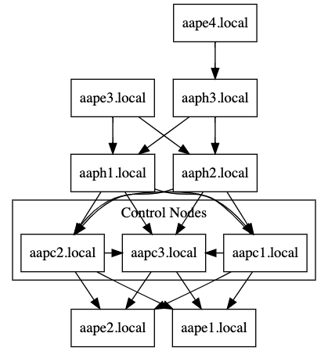
3 controllers, 2 exec nodes + multi hops with exec nodes
control only nodes (: vars) / auto peered together
peers the controllers to the directconnected execution nodes group (ignores hop nodes)
define all execution node types here:
define which exec nodes need a hop
specify which nodes are hops
By using the instance_group_ prefix this will add these nodes into the UI as an instance group via the installer automatically
peer the local_hop group back to the automationcontroller group
Peer the remote_hop group to the local_hop group
[automationcontroller]
aapc1.local ansible_connection=local
aapc2.local
aapc3.local
[automationcontroller:vars]
peers=instance_group_directconnected
node_type=control
[execution_nodes]
aape1.local
aape2.local
aape3.local peers=local_hop
aape4.local peers=remote_hop
aaph1.local node_type=hop
aaph2.local node_type=hop
aaph3.local node_type=hop
[instance_group_directconnected]
aape1.local
aape2.local
[instance_group_localhop]
aape3.local
[instance_group_multihop]
aape4.local
[local_hop]
aaph1.local
aaph2.local
[local_hop:vars]
peers=automationcontroller
[remote_hop]
aaph3.local
[remote_hop:vars]
peers=local_hop
Notes:
Tip: use groups to associate nodes of the same type and cut down noise in the installer configuration

